Slide 1
Creating a Custom Master Page
for a Team Site
Notes:
This lecture discusses how to design and implement custom master pages by beginning with a minimal starter master page. You will learn about the essential placeholders and SharePoint controls that must be added to any master page running in a SharePoint 2010 environment and the instructor will demonstrates how to integrate these controls into a custom page design. The lecture also discusses the best practice of placing certain navigation controls inside delegate controls to ensure your custom master pages work equally well in Team sites as well as Publishing sites.

Slide 2
Agenda
Creating a Starter Master Page
Configuring Sites with a Custom Master Page
Implementing and Testing a Design
Customizing Navigation

Slide 3
Starter Master Page Resources
Randy Drisgall's starter pages
http://startermasterpages.codeplex.com/
Microsoft-supplied Starter Pages
http://archive.msdn.microsoft.com/odcSP14StarterMaster
Notes:
Starter Master Pages for SharePoint 2010 provide you with a clean, commented starting point for creating your own custom master pages in branding projects targeting SharePoint 2010. There is a popular set of starter master pages created by SharePoint legend, Randy Drisgall, which can be downloaded from the URL shown on the slide. These master pages were used as a basis for the master pages you will use in the labs. There is also another set of starter pages supplied by Microsoft.
Note that the term "Minimal Master Page" was used in SharePoint 2007. However, now that Microsoft has added a standard master page named minimal.master, Web designers now use the term "starter master page" to avoid ambiguity.

Slide 4
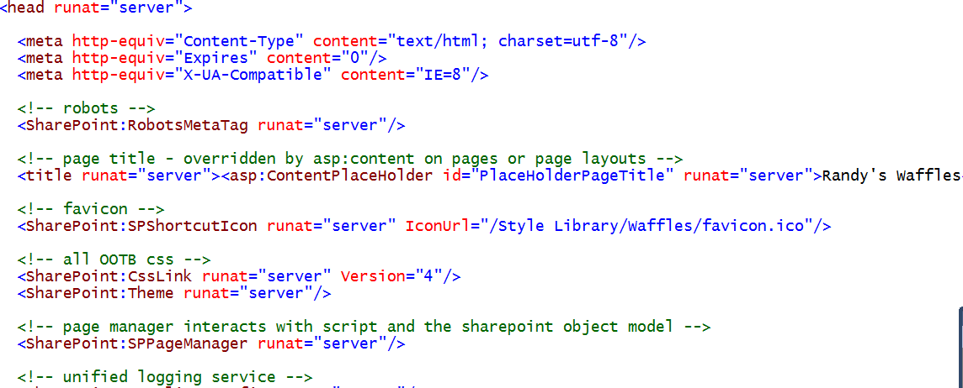
A Starter Master Page for SharePoint 2010
Walk through of a starter master page
c:\Student\Resources\MasterPages\Starter1.master
Notes:
The slide above shows a fragment of the code in one of the Randy Drisgall starter pages. As you can see it is commented and easy to follow. This is especially true if you compare it to v4.master.

Slide 5
DEMO
Examining the master starter page

Slide 6
Agenda
Creating a Starter Master Page
Configuring Sites with a Custom Master Page
Implementing and Testing a Design
Customizing Navigation

Slide 7
Adding a Custom Master Page to the MPG
There are three ways to upload a master page
Add it using SharePoint Designer
Upload it from browser
Upload it from feature inside solution package
Notes:
There are three ways to upload a master page to the master page gallery.
First, you can create a master page or upload an existing one using SharePoint Designer.
Second, you can navigate to the master page gallery in the browser and upload it from there just as you would upload any other document to a document library.
Third, you can upload a master page using a feature you have developed in a SharePoint 2010 solution using Visual Studio 2010.

Slide 8
Configuring a Custom Master Page
Configuring a Custom Master Page is done…
Through browser in publishing sites
Through SharePoint Designer for a single team site
Through code or PowerShell for multiple team sites
Notes:
The way to configure a custom master page depends on whether you are using publishing sites or not. There is an extended user interface only available in publishing sites that allows a privileged user to configure the current site or all the sites in a site collection to use a specific master page. This topic will be discussed in the following lecture.
For team sites, you don't have the same ease to configure master pages. The SharePoint Designer makes it possible to configure the master page for a team site but provides no ability to configure the master page for multiple sites at once nor does it make it possible to configure a child site to use a master page in the master page gallery of a parent site. The only way to configure all the child sites in a site collection to use a master page in the top-level site is to use C# or VB.NET code written against the SharePoint object model or to write the same type of code in a Windows PowerShell script.

Slide 9
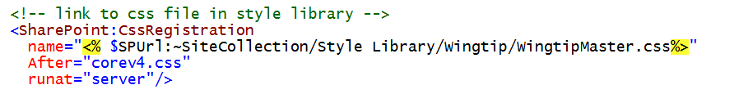
Adding a Custom CSS File
Upload CSS file
Upload CSS File and related images to Style Library
Link Master Page to CSS file
Add CssRegistration control to head section
Notes:
One of the best ways to reuse a CSS file is to add it to the Style Library of a top-level site. This makes it easy to reuse across all the pages within a site collection. Once you have uploaded a CSS file into the Style Library, you can link to it using the CssRegistration control and an $SPUrl expression.

Slide 10
Agenda
Creating a Starter Master Page
Configuring Sites with a Custom Master Page
Implementing and Testing a Design
Customizing Navigation

Slide 11
DEMO
Implementing and Testing a Design
Notes:
Your instructor will perform a demonstration to walk you through the steps of implementing a master page from a starter master page file.

Slide 12
Agenda
Creating a Starter Master Page
Configuring Sites with a Custom Master Page
Implementing and Testing a Design
Customizing Navigation

Slide 13
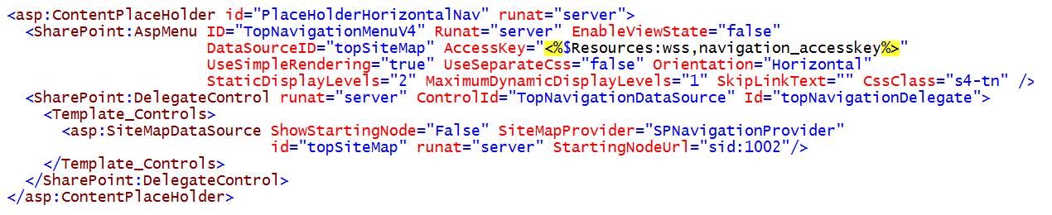
Delegates Revisited
Delegates used to provide compatibility
v4.master provide data source for team sites
Delegate control allows publishing sites to replace them
Delegates create compatibility in master pages
Not using delegates means you are hardcoding your master pages to either team sites or to publishing sites
Notes:
In SharePoint 2010, delegate controls used to provide master page compatibility between teams sites and publishing sites. The slide above shows a snippet from v4.master which uses a delegate with a ControlId attribute value of TopNavigationDataSource. Inside this delegate is the SiteMapDataSource control that works with team sites. However, when the publishing features are activated, they are designed to replace this data source with an instance of the PublishingNavigation:PortalSiteMapDataSource which supplies the correct data source for publishing sites.
Delegate control allow for a master page that works in both team sites and also with publishing sites. Some master pages, such as the starter master pages created by Randy Drisgall do not use delegates but instead hard code the PortalSiteMapDataSource. This results in a master page that works fine in publishing sites but does not work correctly in any other type of site. Therefore, it is recommended that you follow what is in v4.master and use delegates for the data sources for the Top Link bar as well as the Quick Launch bar.

Slide 14
Agenda
Creating a Starter Master Page
Configuring Sites with a Custom Master Page
Implementing and Testing a Design
Customizing Navigation

